Slide 1

Mini project Presentation SESSION 2022-23
Axis Institute Of Technology And Management
Computer Science & Engineering
Deepak dixit 1907190100018
Kamruddin 1907190100025
Member Name University Roll No

Slide 2
Project Title
Health issue management
The Health Management System In Python was developed using Python Programming.

Slide 3
Project Description
A Health Issue Management System Python it allows the doctors to look for a patient’s medical record and to see the various sorts of diseases and their symptoms and cures. This also allows doctors to update the disease table. Also, this software allows doctors to update a patient’s medical record or add a new patient. The design is so simple that the user won’t find any difficulties while working on it.
This software will help the company to be more efficient in registration of their patients and manage appointments, records of patients. It enables doctors and admin to view and modify appointments schedules if required. The purpose of this project is to computerize all details regarding patient details and hospital details.

Slide 4
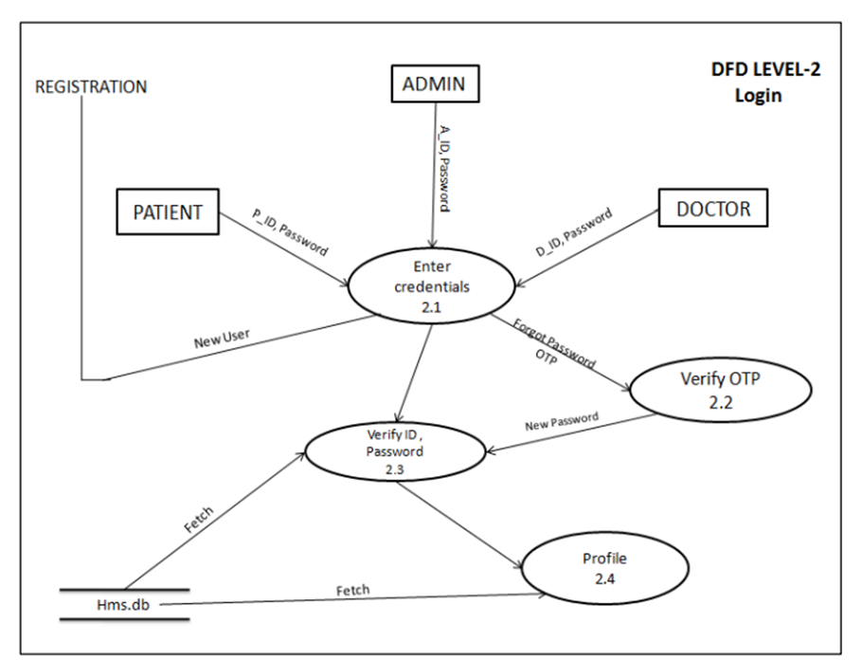
Project Flow

Slide 5
Technology Used
The Health Management System In Python was developed using Python Programming, This Health Management System Project In Python project is made as a part of the Database Management System Project using SQL Lite 3 and Python 3. This is a system that stores and retrieves data associated with medical treatment

Slide 6
Python
Python is a general-purpose, versatile, and powerful programming language. It’s a great first language because Python code is concise and easy to read. Whatever you want to do, python can do it. From web development to machine learning to data science, Python is the language for you.

Slide 7
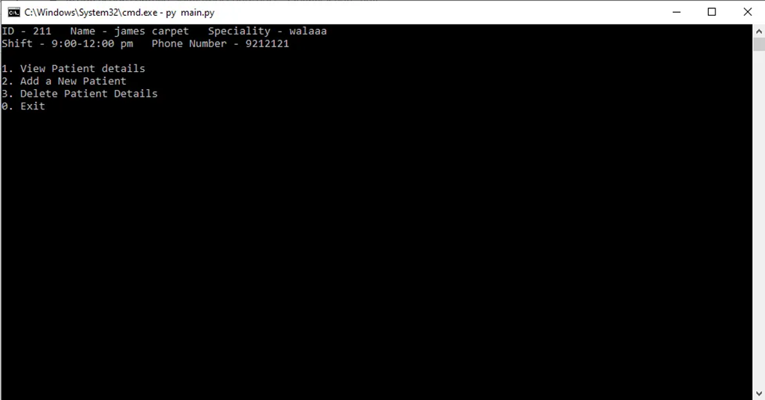
Screens

Slide 8
Discussion
Effectivelycommunication between patients, physicians,nurses, pharmacists, and other healthcare professionals is vital to goodhealthcare. Current communication mechanisms, basedlargely on paper records and prescriptions, are oldfashioned, inefficient, and unreliable.When multiple healthcare professionals and facilities are involved in providing healthcare for a patient, the healthcare services provided aren’toften coordinated. Typically, a physician writes a prescription on paper andgives it to the patient.

Slide 9
Conclusion
The hospital management system could handle specific task such as securing various information of the patients. This will help them secure the data to keep patient-doctor confidentiality as well as assure them of their healing factors. It can also improve the productivity of the, health care workers and could let them accommodate more patients.

Slide 10
Refrences
CodeWithHarry- https://www.codewithharry.com/tutorial/python
Learnit- https://www.learnit.nl/info/python

